Slide 1


Personalized Legal Chatbot for Egyptian Constitution
RAG model-based retrieval and dynamic response generation.

Slide 2
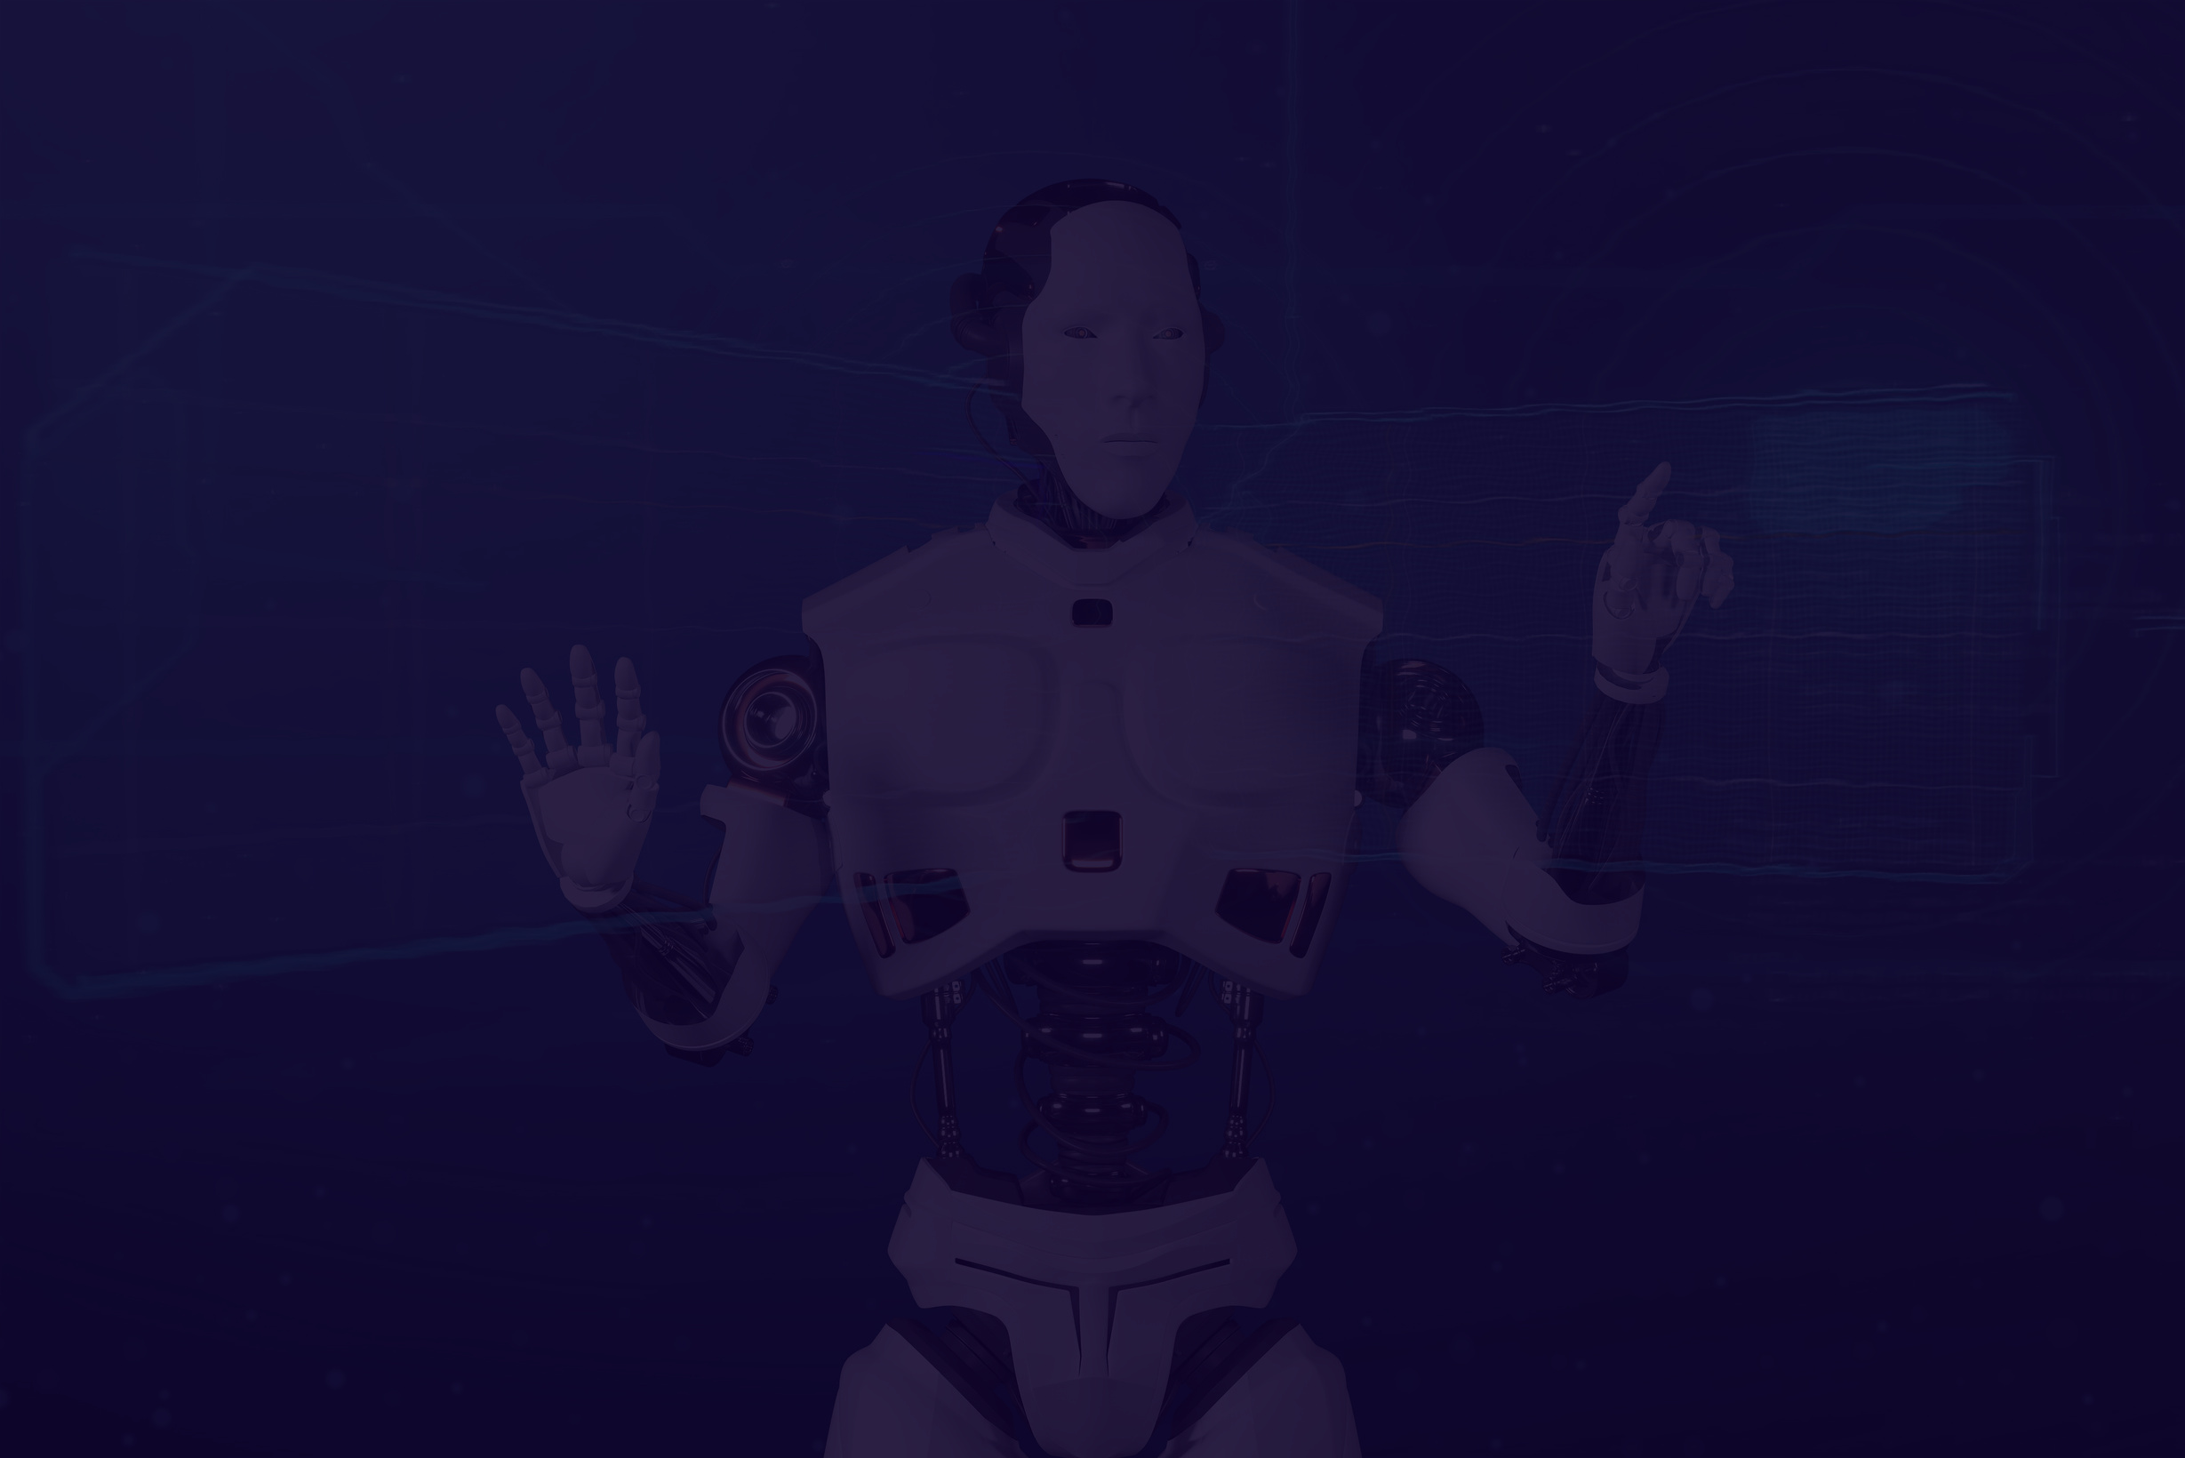
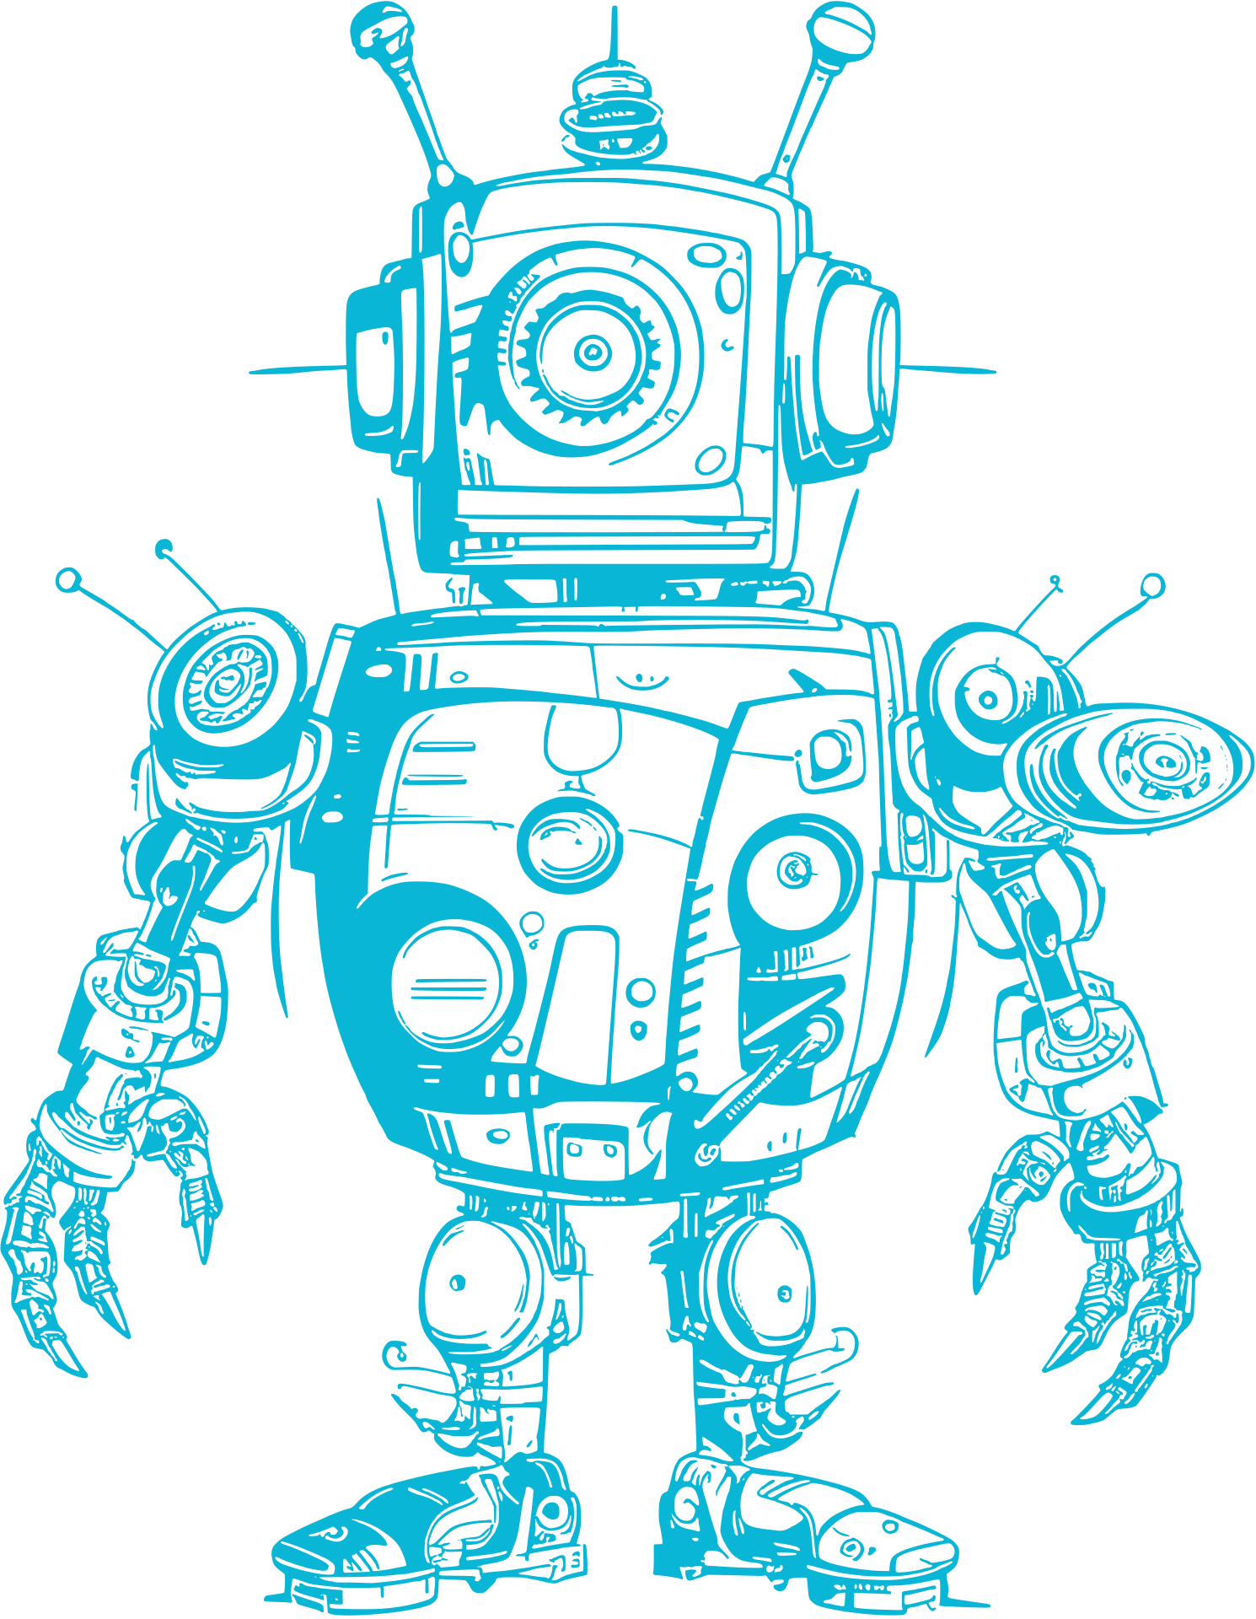
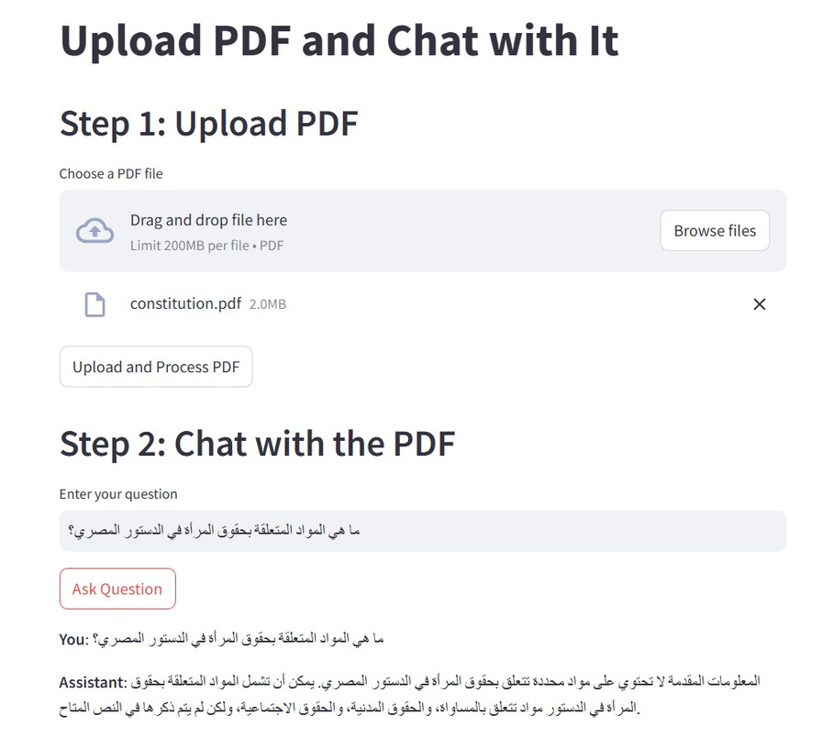
02
Project Overview
Our generative AI project aims to develop an intelligent chatbot capable of retrieving information and answering questions about the Egyptian Constitution in Arabic.
The chatbot allows users to upload a PDF version of the Constitution and then interact with it by asking questions. =

Slide 3
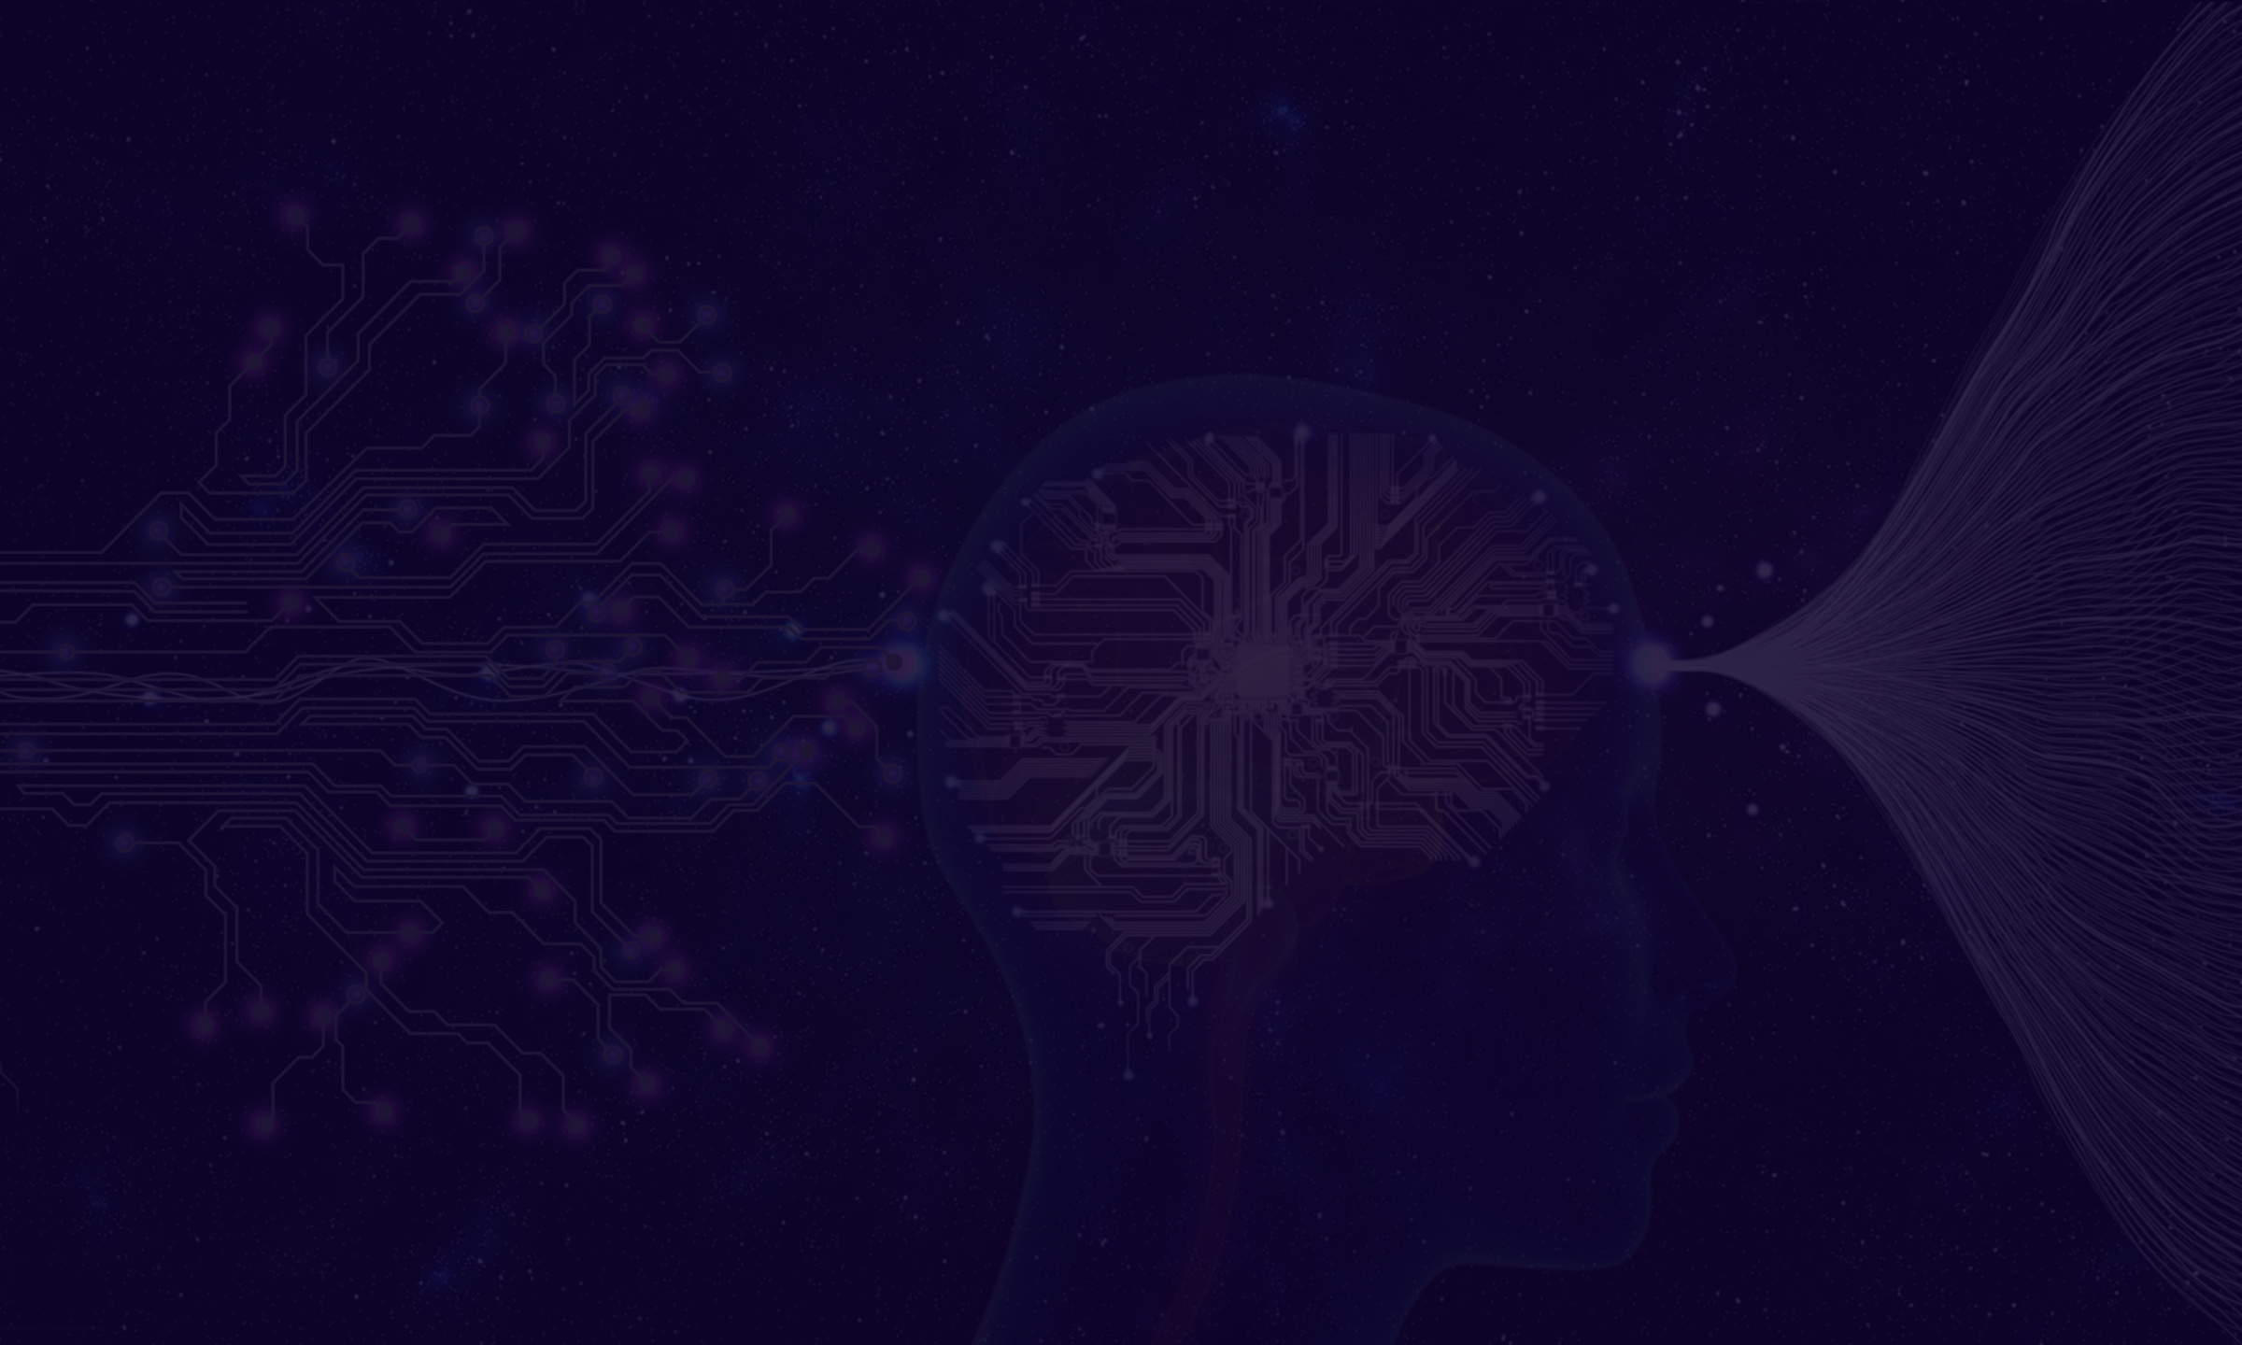

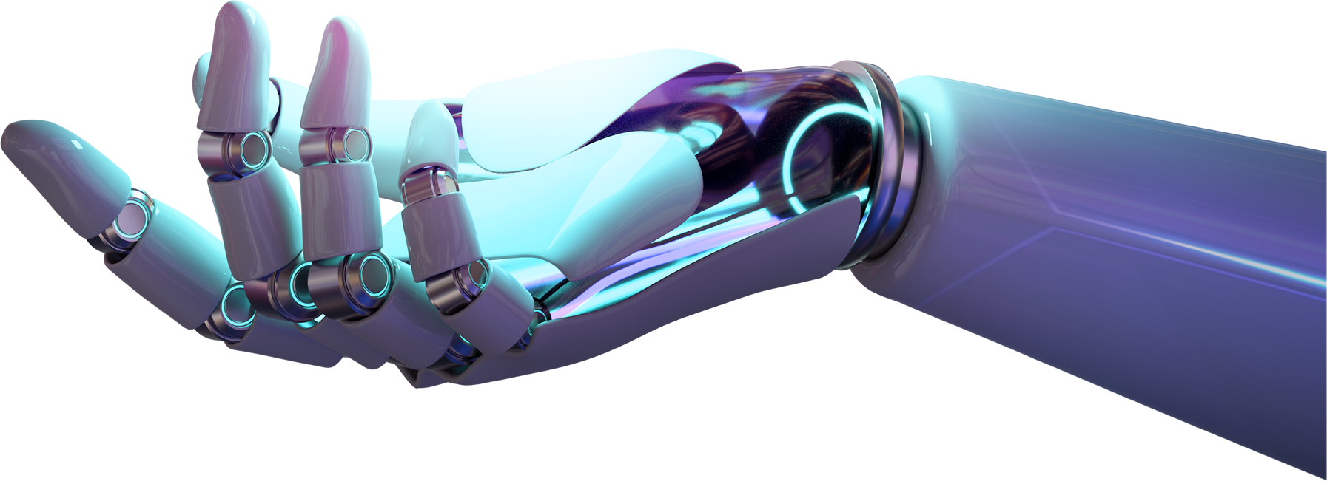
NLP Approach
RAG Model:
Retrieval-Augmented Generation (RAG):
Combines retrieval techniques with generative models.
LlamaIndex Integration: Enhances understanding and retrieval of legal articles from the Egyptian Constitution.
Personalization: Adapts responses based on user input for more accurate answers.
03

Slide 4

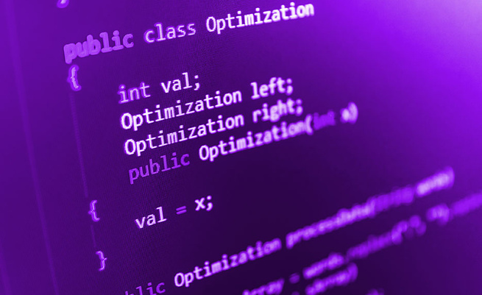

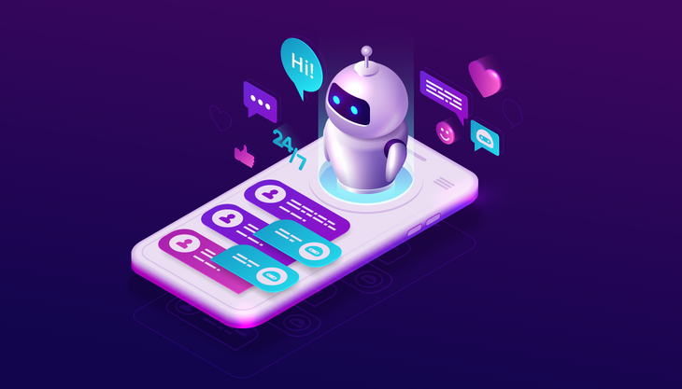
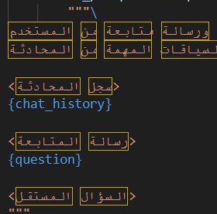
04
Methodology
Data Collection & Preprocessingion
Chatbot Development and Training
Advanced Techniques and Integration
UI
Clean, normalize, and engineer data.
Utilizing LlamaIndex for better retrieval efficiency and fine tuning
Handling complex legal queries
Showcase chatbot performance and its interaction flow.

Slide 5
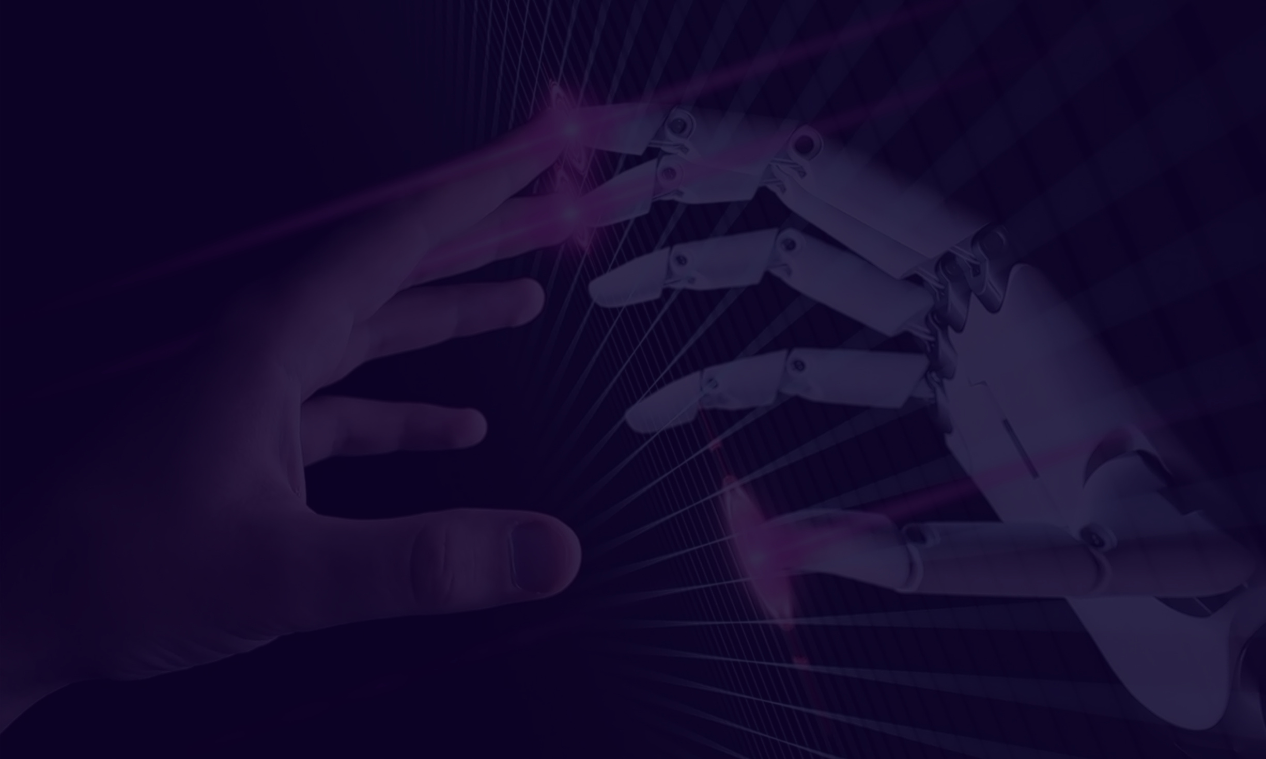


05
thynk unlimited
Data Collection and Preprocessing
Data Source: Egyptian Constitution in Arabic.
Week 1:
Tasks: Data gathering, cleaning, tokenization, and embedding.
Focus: Preparing the text for effective retrieval and response generation.

Slide 6
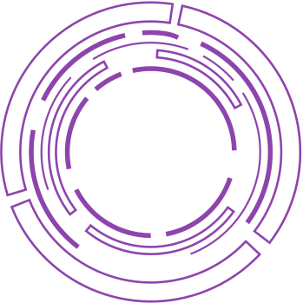


06
Chatbot Development
Week 2:
developing and training the chatbot.
integrated the RAG model for effective question-answering, using LlamaIndex to enhance retrieval efficiency.
fine-tuned the model to understand and accurately respond to specific constitutional articles, ensuring that context-aware answers to users' legal queries.

Slide 7


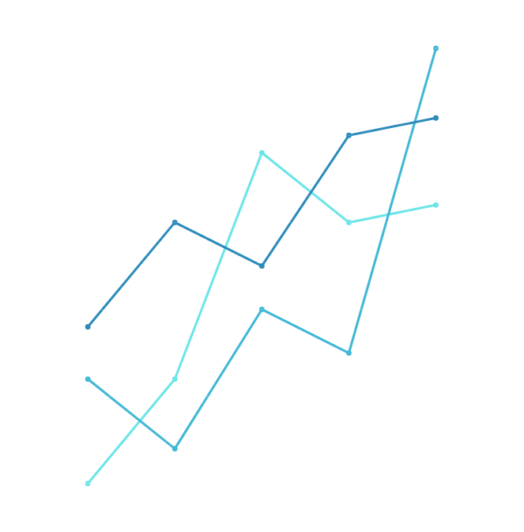
07
Advanced Techniques and Integration
Week 3:
we implemented advanced techniques to enhance the chatbot's performance.
Key features include generating context-aware responses
handling complex legal queries effectively
employing prompt engineering techniques to optimize interactions. Integration e
refining the model’s interpretability, ensuring a seamless and understandable interaction flow.

Slide 8



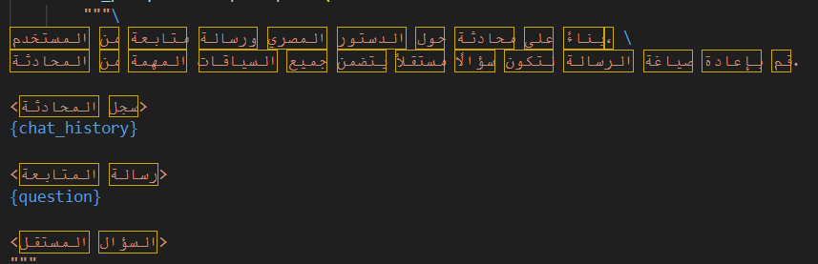
UI
Week 4:
we focused on developing a user-friendly frontend using Streamlit, allowing for smooth interactions with the chatbot. The final demo showcased the chatbot’s performance and interaction flow, demonstrating its ability to provide accurate legal responses in real-time.
08

Slide 9
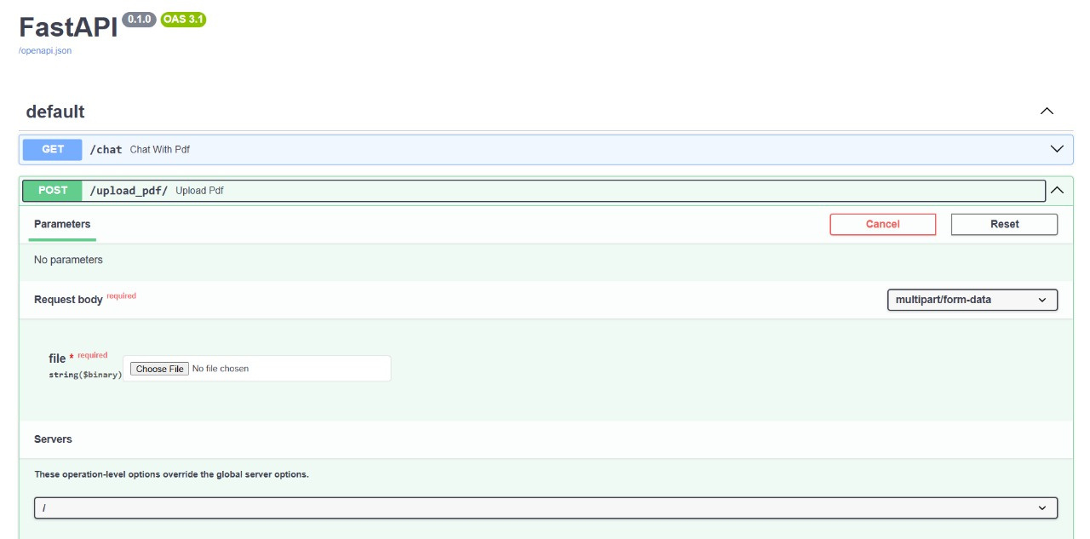
Fast API
In this project, we implemented two key endpoints:
- GET Endpoint: Enables users to retrieve and interact with the content of a PDF via chat functionality.
- POST Endpoint: Allows users to upload a PDF file for processing and future interactions.
This structure optimizes the user experience by providing a seamless way to engage with PDF documents, whether through upload or real-time communication with the file's content.

Slide 10


Future Directions
The project successfully achieved dynamic Arabic response generation and personalized legal consultation focused on Egyptian constitutional matters. Key accomplishments include accurate retrieval, context-aware answers, and effective handling of complex legal queries. Future improvements will focus on expanding the chatbot to other legal domains and enhancing response accuracy for broader applicability.

Slide 11


Thank You!
Team names:
- Abdelrhman Mohamed Ali
- Kenzy Mohamed Ali
- Mohamed Tarek Fath
- Abdelrhman Mohamed Mahmoud
- Marwan Tamer Mahmoud
- Bassant Tarek Ahmed

